Slide 1
Electrical Circuits
AC Circuits

Slide 2
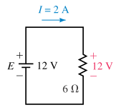
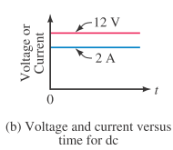
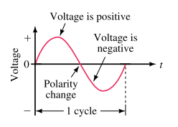
AC Fundamentals
Previously you learned that DC sources have ﬁxed polarities and constant magnitudes and thus produce currents with constant value and unchanging direction
In contrast, the voltages of ac sources alternate in polarity and vary in magnitude and thus produce currents that vary in magnitude and alternate in direction.

Slide 3
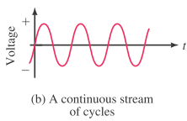

AC Fundamentals
Sinusoidal ac Voltage
One complete variation is referred to as a cycle.
Starting at zero, the voltage increases to a positive peak amplitude, decreases to zero, changes polarity, increases to a negative peak amplitude, then returns again to zero.
Since the waveform repeats itself at regular intervals, it is called a periodic signal.
Symbol for an ac Voltage Source
Lowercase letter e is used to indicate that the voltage varies with time.

Slide 4
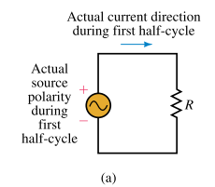
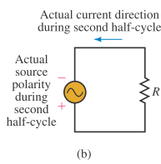
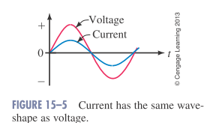
Sinusoidal ac Current
During the ﬁrst half-cycle, the source voltage is positive
Therefore, the current is in the clockwise direction.
During the second half-cycle, the voltage polarity reverses
Therefore, the current is in the counterclockwise direction.
Since current is proportional to voltage, its shape is also sinusoidal

Slide 5
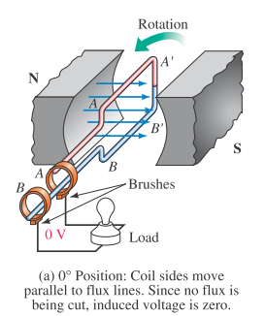
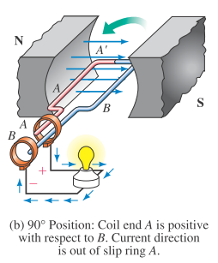
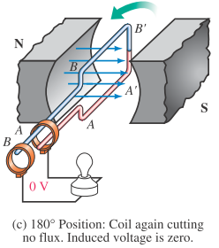
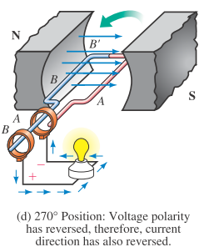
Generating ac Voltages (Method A)
One way to generate an ac voltage is to rotate a coil of wire at constant angular velocity in a ﬁxed magnetic ﬁeld
The magnitude of the resulting voltage is proportional to the rate at which ﬂux lines are cut
its polarity is dependent on the direction the coil sides move through the ﬁeld.

Slide 6
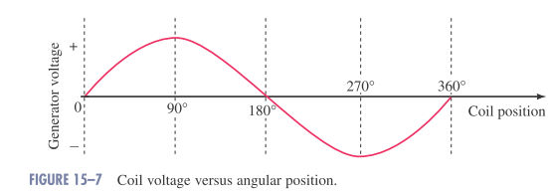
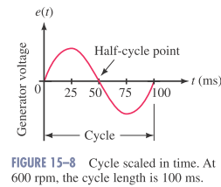
Generating ac Voltages
Since the coil rotates continuously, the voltage produced will be a repetitive,
Often we need to scale the output voltage in time.
The length of time required to generate one cycle depends on the velocity of rotation.
Time Scales
600 revolutions in 1 minute = 600 rev / 60 s
= 10 revolutions in 1 second.
The time for 1 revolution = one-tenth of a second
= 100 ms

Slide 7

The Basic Sine Wave Equation
The voltage produced by the previously described generator is:
Em: the maximum coil voltage and
α : the instantaneous angular position of the coil.
For a given generator and rotational velocity, Em is constant.)
Note that a 0° represents the horizontal position of the coil and that one complete cycle corresponds to 360°.

Slide 8
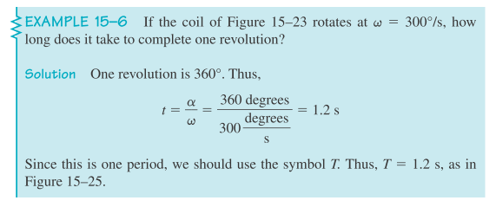
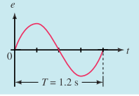
Angular Velocity (ω)
The rate at which the generator coil rotates is called its angular velocity
If the coil rotates through an angle of 30° in one second, its angular velocity is 30° per second.
When you know the angular velocity of a coil and the length of time that it has rotated, you can compute the angle through which it has turned using:

Slide 9
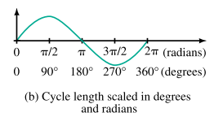

Radian Measure
In practice, ω is usually expressed in radians per second
Radians and degrees are related by :
For Conversion:

Slide 10
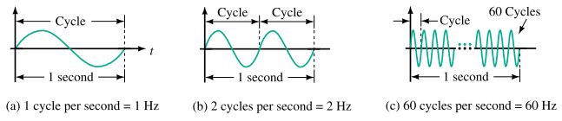

Attributes of Periodic Waveforms
Periodic waveforms (i.e., waveforms that repeat at regular intervals), regardless of their wave shape, may be described by a group of attributes such as:
Frequency, Period, Peak value, Average Value and RMS Value
Frequency:
The number of cycles per second of a waveform is defined
Frequency is denoted by the lower-case letter f.
In the SI system, its unit is the hertz (Hz, named in honor of pioneer researcher Heinrich Hertz, 1857–1894).

Slide 11
Attributes of Periodic Waveforms
Frequency Ranges:
The range of frequencies is huge.
Power line frequencies, for example, are 60 Hz in North America and 50 Hz in many other parts of the world.
Audible sound frequencies range from about 20 Hz to about 20 kHz.
The standard AM radio band occupies from 550 kHz to 1.6 MHz
The FM band extends from 88 MHz to 108 MHz.
TV transmissions occupy several bands in the 54-MHz to 890-MHz range.
Above 300 GHz are optical and X-ray frequencies.

Slide 12
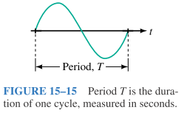

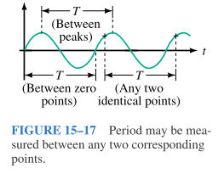
Attributes of Periodic Waveforms
Period:
The period, T, of a waveform, is the duration of one cycle.
It is the inverse of frequency.
The period of a waveform can be measured between any two corresponding points (Often it is measured between zero points because they are easy to establish on an oscilloscope trace).

Slide 13



Relationship between ω, T, and f
Earlier you learned that one cycle of sine wave may be represented as either:
Substituting these into:
Sinusoidal Voltages and Currents as Functions of Time:

Slide 14
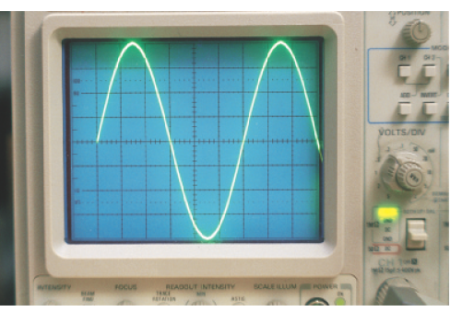
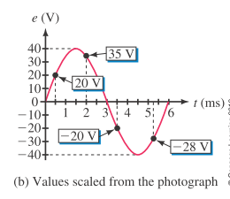
Instantaneous Value
As the coil voltage changes from instant to instant. The value of voltage at any point on the waveform is referred to as its instantaneous value.
The voltage has a peak value of 40 volts
The cycle time of 6 ms.
at t = 0 ms, the voltage is zero.
at t=0.5 ms, the voltage is 20V.

Slide 15
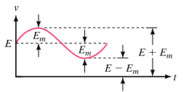
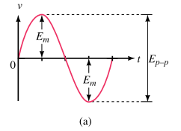
Attributes of Periodic Waveforms
Peak-Value, and Peak-to-Peak Value
Peak Value
The peak value of a voltage or current is its maximum value with respect to zero.
Peak voltage = E + Em
Peak-to-Peak Value (Ep-p):
It is measured between minimum and maximum peaks.

Slide 16
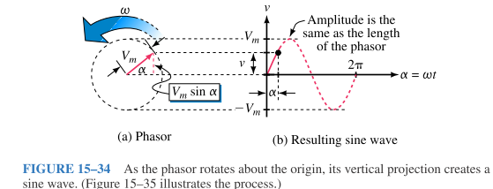
Introduction to Phasors
A phasor is a rotating line whose projection on a vertical axis can be used to represent sinusoidally varying quantities.
To get at the idea, consider the red line of length Vm shown in Figure :
The vertical projection of this line (indicated in dotted red) is :
By assuming that the phasor rotates at angular velocity of ω rad/s in the counterclockwise direction

Slide 17
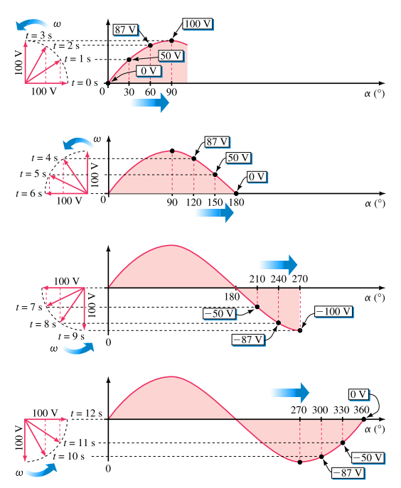
Introduction to Phasors

Slide 18
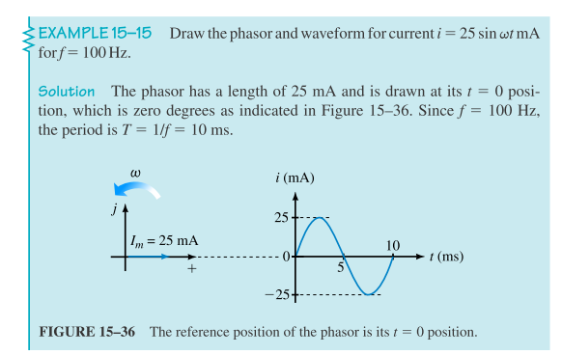
Introduction to Phasors

Slide 19
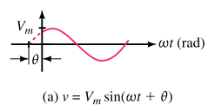
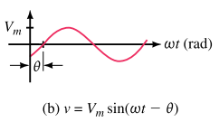
Voltages and Currents with Phase Shifts
If a sine wave does not pass through zero at t =0 s, it has a phase shift.
Waveforms may be shifted to the left or to the right

Slide 20
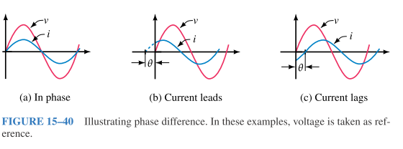
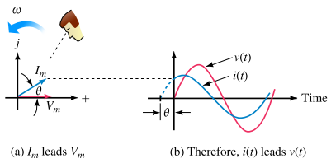
Phasor Difference
Phase difference refers to the angular displacement between different waveforms of the same frequency.
The terms lead and lag can be understood in terms of phasors. If you observe phasors rotating as in Figure, the one that you see passing first is leading and the other is lagging.

Slide 21


Slide 23

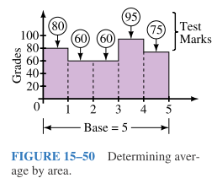

AC Waveforms and Average Value
Since ac quantities constantly change its value, we need one single numerical value that truly represents a waveform over its complete cycle.
To find the average of a set of marks for example, you add them, then divide by the number of items summed.
For waveforms, the process is conceptually the same. You can sum the instantaneous values over a full cycle, then divide by the number of points used.
The trouble with this approach is that waveforms do not consist of discrete values.
Average in Terms of the Area Under a Curve:
Or use area

Slide 24
AC Waveforms and Average Value
To find the average value of a waveform, divide the area under the waveform by the length of its base.
Areas above the axis are counted as positive, while areas below the axis are counted as negative.
This approach is valid regardless of wave shape.
Average values are also called dc values, because dc meters indicate average values rather than instantaneous values.

Slide 25
Root Mean Square (RMS) Value
Most equipment that measure the amplitude of a sinusoidal signal displays the results as a root mean square value. This is signified by the unit Vac or V_{RMS.}
RMS voltage and current are used to calculate the average power associated with the voltage or current signal in one cycle.

Slide 26
AC ammeters and voltmeters are designed to read rms values.
Many of the equations that will be used have the same form as their DC counterparts.
Form Factor =
or
Peak Factor =
or

Slide 27
Calculate Form Factor to the sources

Slide 28
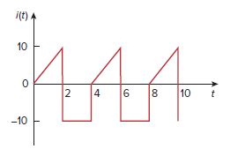

Slide 29
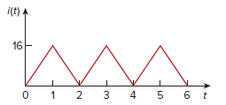

Slide 30
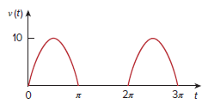

Slide 31
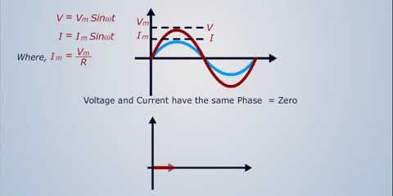
Resistors in an AC Circuit
The current is a maximum when the voltage across the resistor is maximum.
For a sinusoidal applied voltage, the current in an inductor always in phase with the voltage across the resistor.
Resistive Impedance (Z) = R

Slide 32
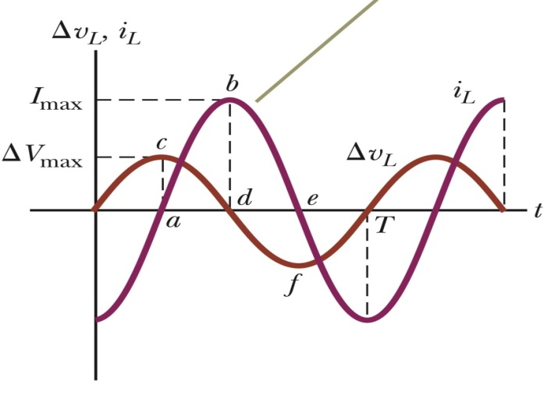
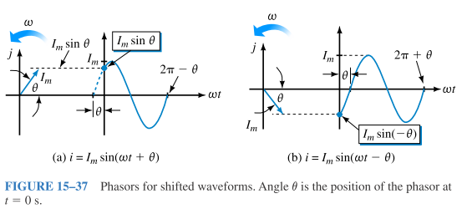
Inductors in an AC Circuit
The current is a maximum when the voltage across the inductor is zero.
The current in an inductor always lags behind the voltage across the inductor by 90° (π/2).
The factor is the inductive reactance and is given by:
X_{L} = ωL
The impedance Z of a circuit is the ratio of the phasor voltage V to the phasor current I, measured in ohms (Ω).
Inductive Impedance (Z_{L}) = jX_{L} = j ωL
The admittance Y is the reciprocal of impedance, measured in siemens (S).
Inductive Admittance (Y_{L}) = 1/Z = 1/jX_{L} = -j/X_{L}

Slide 34
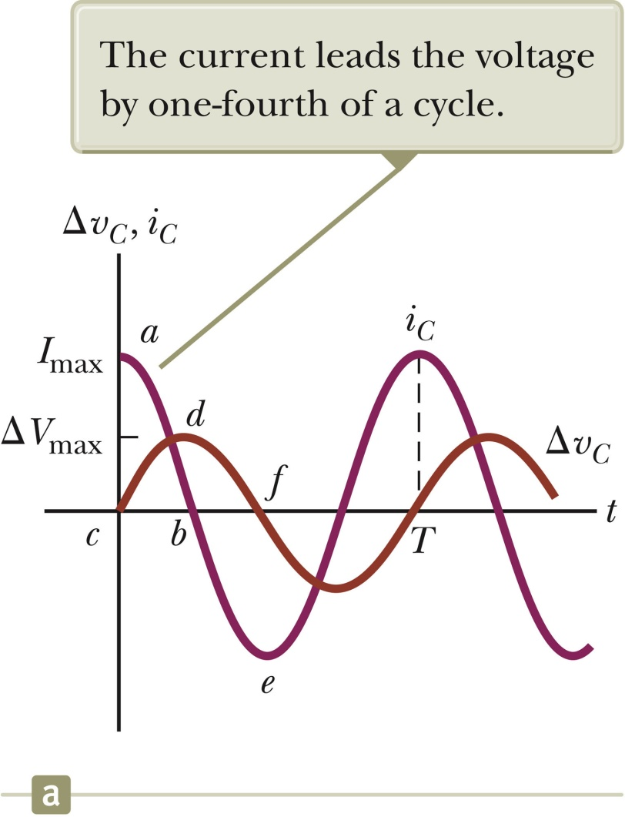
Capacitors in an AC Circuit
The current reaches its maximum value one quarter of a cycle sooner than the voltage reaches its maximum value.
The current leads the voltage by 90º.
The impeding effect of a capacitor on the current in an AC circuit is called the capacitive reactance and is given by
Capacitive Impedance (Zc) = -j Xc
Capacitive Admittance (Zc)=1/ (-j Xc) = j/Xc

Slide 36

Memory Aid for AC Elements
An old, but very effective, way to remember the phase differences for inductors and capacitors is :
“E L i”
the
“I C E”
man
“E L I” the “i C E” Man
Emf E is before current i in inductors L;
Emf E is after current i in capacitors C.

Slide 37
Frequency and AC Circuits
Resistance R is constant and not affected by f.
Inductive reactance X_{L} varies directly with frequency.
Capacitive reactance X_{C} varies inversely with f.
R, X
X_{C}
X_{L}
R
f

Slide 38
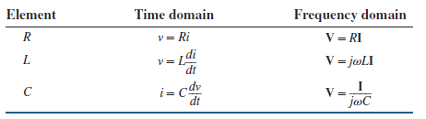
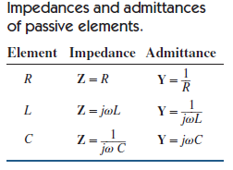
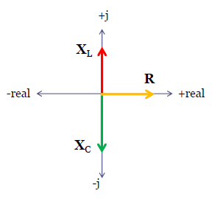

Slide 39




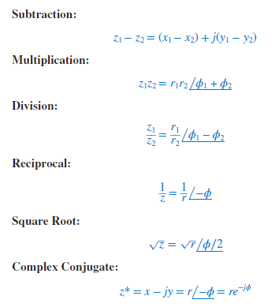

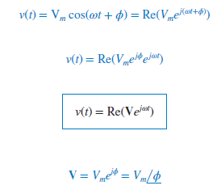

Slide 40


Slide 41
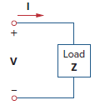
AC Power Analysis
Instantaneous power (in watts) is the power at any instant of time.
p(t) = v(t)i(t)
Complex Power S = VI* = P + jQ
Active Power P= Re(S) = VIcos(φ) (Watts)
Reactive Power Q= Im(S) = VIsin(φ) (VAR)
v(t)=v_{m}sin(ωt) = V∟0 i(t)=i_{m}sin(ωt+ φ) = I∟φ
Apparent Power S = VI (VA)
Power Factor = Active Power /Apparent Power = cos(φ)

Slide 42


Slide 43
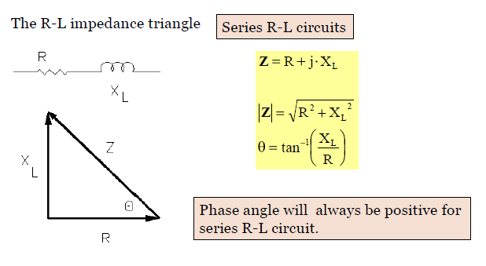
Series RL Circuits

Slide 44
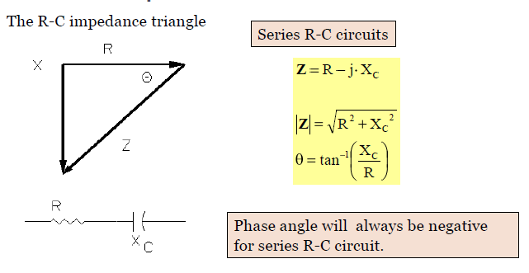
Series RC Circuits

Slide 45


Slide 46


Slide 47
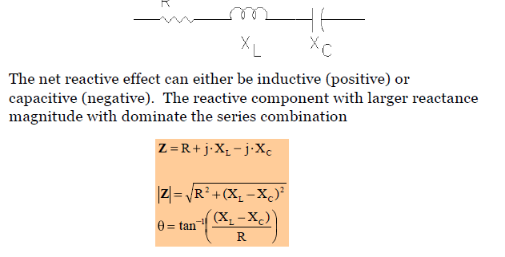
Series RLC Circuits

Slide 48
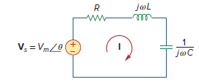
Resonance
Resonance is a condition in an RLC circuit in which the capacitive and inductive reactances are equal in magnitude, thereby resulting in a purely resistive impedance.
Resonant circuits (series or parallel) are useful for constructing filters
Note that at resonance:
The impedance is purely resistive, thus, Z = R. In other words, the LC series combination acts like a short circuit, and the entire voltage is across R.
Im(Z)=0
The voltage Vs and the current I are in phase, so that the power factor is unity.
The magnitude of Z is minimum and I is maximum.
The inductor voltage and capacitor voltage can be much more than the source voltage.

Slide 49
at resonance
The highest power dissipated occurs at resonance, when I = Vm∕R, so that
At certain frequencies ω = ω1, ω2, the dissipated power is half the maximum value; that is,
Hence, ω1 and ω2 are called the half-power frequencies.
We can relate the half-power frequencies with the resonant frequency.

Slide 50

The width of the response curve depends on the bandwidth B, which is defined as the difference between the two half-power frequencies,
The “sharpness” of the resonance in a resonant circuit is measured quantitatively by the quality factor Q.
The quality factor relates the maximum or peak energy stored to the energy dissipated in the circuit per cycle of oscillation:
The quality factor of a resonant circuit is the ratio of its resonant frequency to its bandwidth.

Slide 51
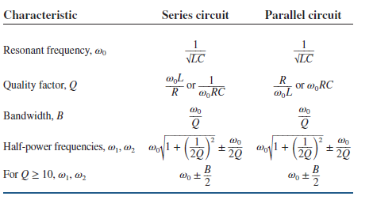

Slide 52
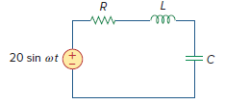
In the circuit of Fig. R = 2 Ω, L = 1 mH, and C = 0.4 μF. (a) Find the resonant frequency and the half-power frequencies. (b) Calculate the quality factor and bandwidth. (c) Determine the amplitude of the current at ω0, ω1, and ω2.

Slide 54

Determine the resonant frequency of the circuit in Fig.

Slide 55

Determine the resonant frequency of the circuit in Fig.

Slide 56

At ω = 377 rad/s, find the input impedance of the circuit shown in Fig.

Slide 57

Determine Z_{T} and I for the circuit in

Slide 58

At ω = 1 rad/s, obtain the input admittance in the circuit of Fig.

Slide 59

Find v(t) and i(t) in the circuit shown in Fig

Slide 60

Determine v(t) and i(t).

Slide 61

Find v s (t) in the circuit of Fig if the current ix through the 1-Ω resistor is
8 sin 200t A.

Slide 62

Find i_{x} in the circuit of Fig using nodal analysis

Slide 63

Determine current Io in the circuit of Fig. using mesh analysis.

Slide 64
CONCLUSION: AC Circuits

